Slide 1

DMC – Papa John’s Rota
Adam Speers, Petrut Vasile, Toby White

Slide 2
Finding a Brief
Team Formation
The Search
Papa John’s
Notes:
TOBY

Slide 3

Brief Outline
Rota System
Web Accessible
Employee Shifts and Holiday
Managerial Control
Notes:
PETE

Slide 4

Client Feedback
Regular Meetings
Verbal Feedback
Sign Off on Documents – Caveats
Notes:
TOBY

Slide 5
Project Timeline
Initial Investigation
Document Requirements
Prototyping
Feedback
Iterative Development Cycle
Notes:
ADAM

Slide 6
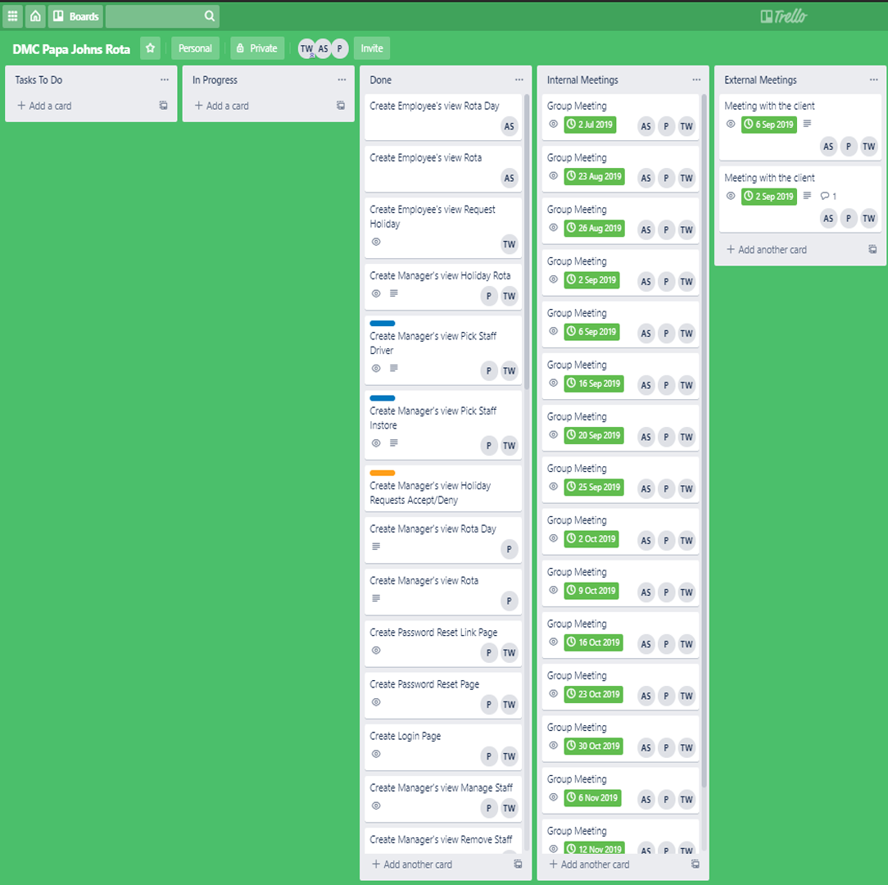
Project Management
Trello
GitHub - https://github.com/Aespeers/Level6_DMC.git
Regular Client Updates
Weekly Minutes
Two Weekdays, Fourteen Weeks
Notes:
ADAM

Slide 7
Requirements
User Stories
High Level Requirements Document
Prioritisation
Notes:
TOBY

Slide 8

Product Evaluation
Cost-Benefit Analysis
Evaluation Matrix
Wix
Bubble
Wordpress
Manual
Notes:
ADAM

Slide 9
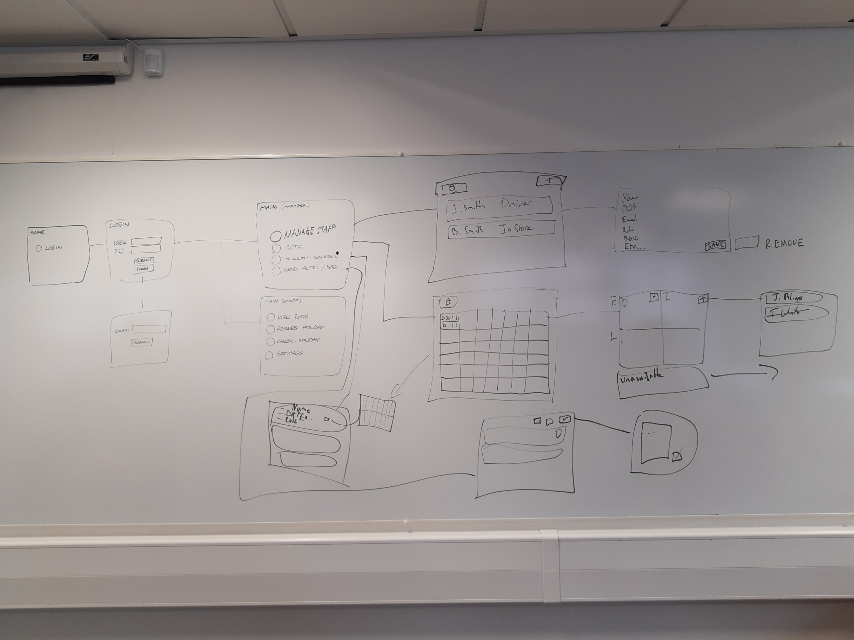
Prototyping
Whiteboards
Pencil
Notes:
TOBY

Slide 10
Iterative Development Cycle
Design
Build
Test
Challenges
Notes:
PETE

Slide 11
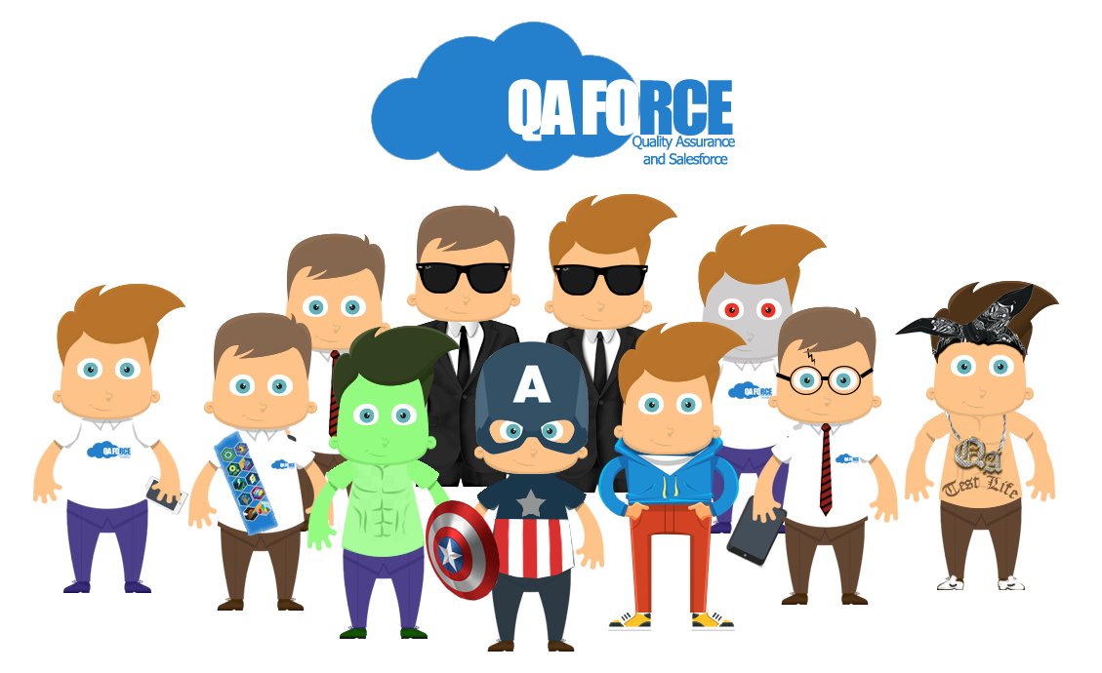
QA
Smoke Tests
Defects
Regression Testing
Notes:
TOBY

Slide 12
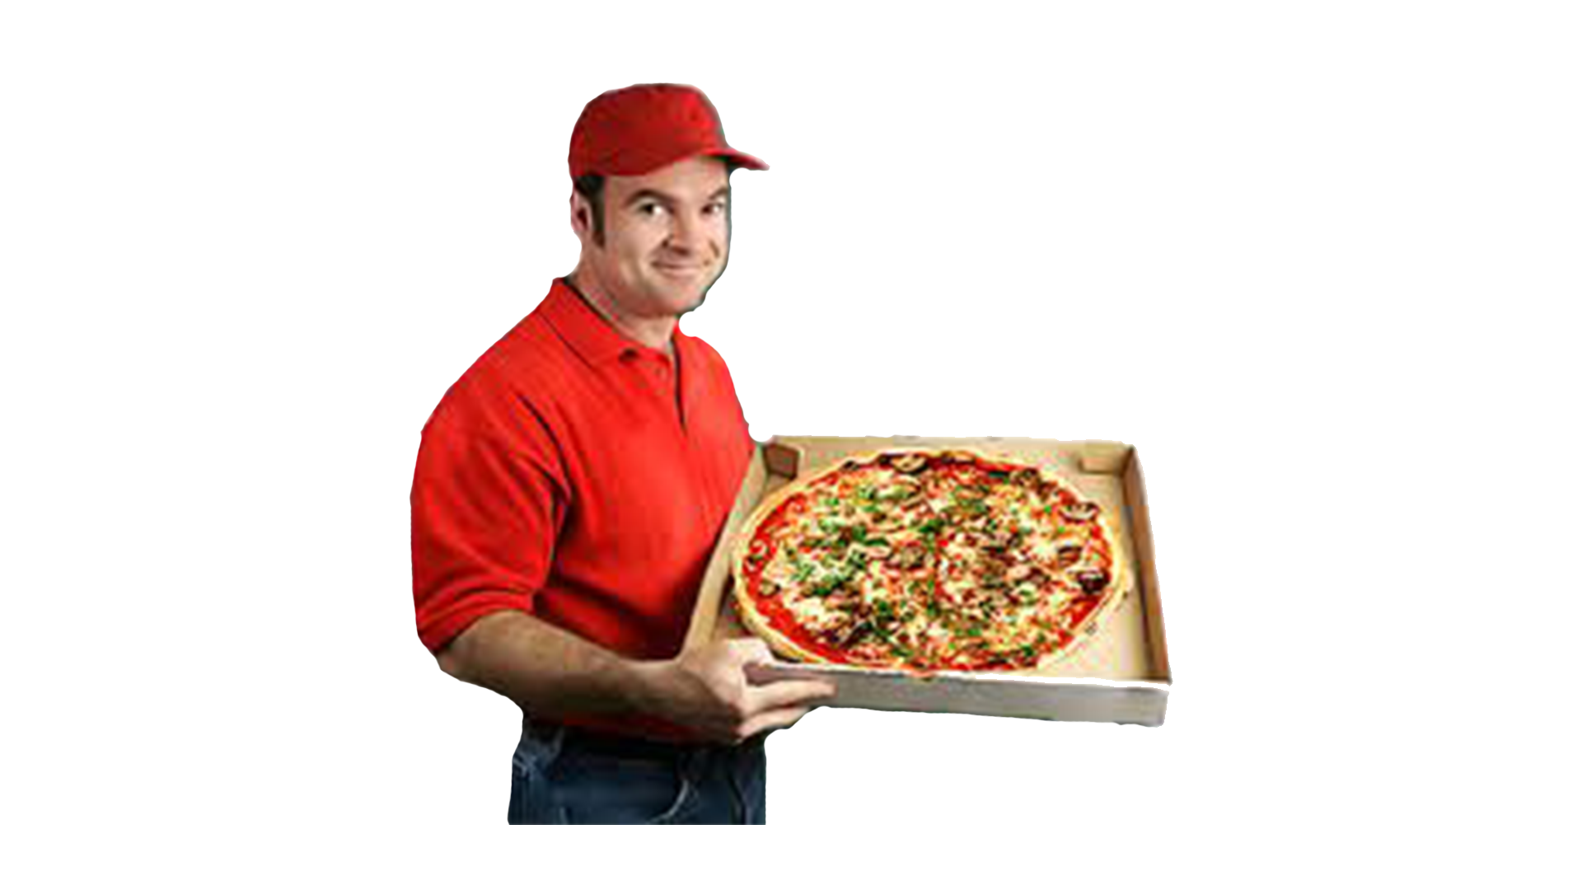
Product Delivery
Product Live as of 25th November 2019
Warranty
No Bugs Reported

Slide 13
Self-Reflection
The Good, the Bad, and the Ugly

Slide 14
Bibliography
Hughes, B., & Cotterell, M. (2002). Software project management . Maidenhead: McGraw Hill.
Keith, C. (2010). Agile game development with Scrum. London: Addison-Wesley.

Slide 15
Questions?

